Slide 1

LEARN ABOUT COLORS
BY : SCIENCE GENIUS

Slide 2
yellow

Slide 3



let's name objects that are color yellow
lemon
sunflower
sun

Slide 4
blue

Slide 5


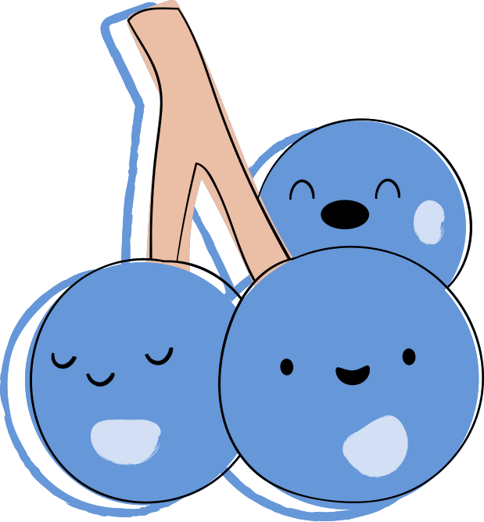
let's name objects that are color blue
blue whale
blueberry
pants

Slide 6
green

Slide 7
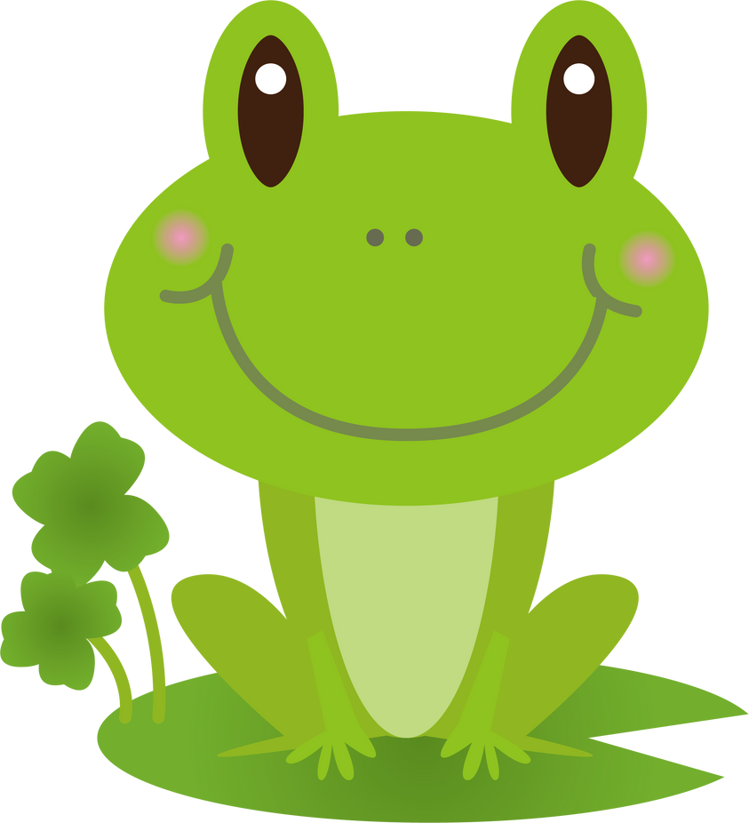

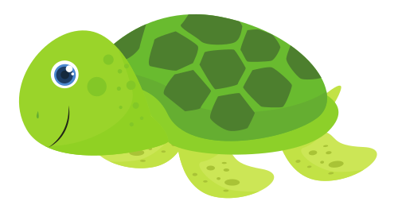
let's name objects that are color green
turtle
leaf
frog

Slide 8
red

Slide 9

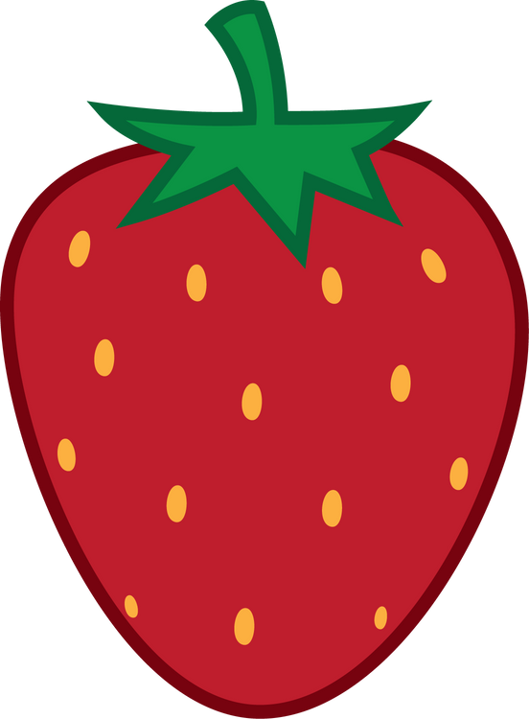

let's name objects that are color red
apple
chili
strawberry

Slide 10
purple

Slide 11


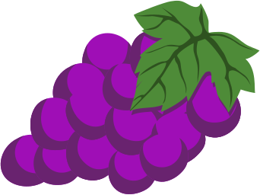
let's name objects that are color purple
eggplant
grapes
flower

Slide 12
orange

Slide 13
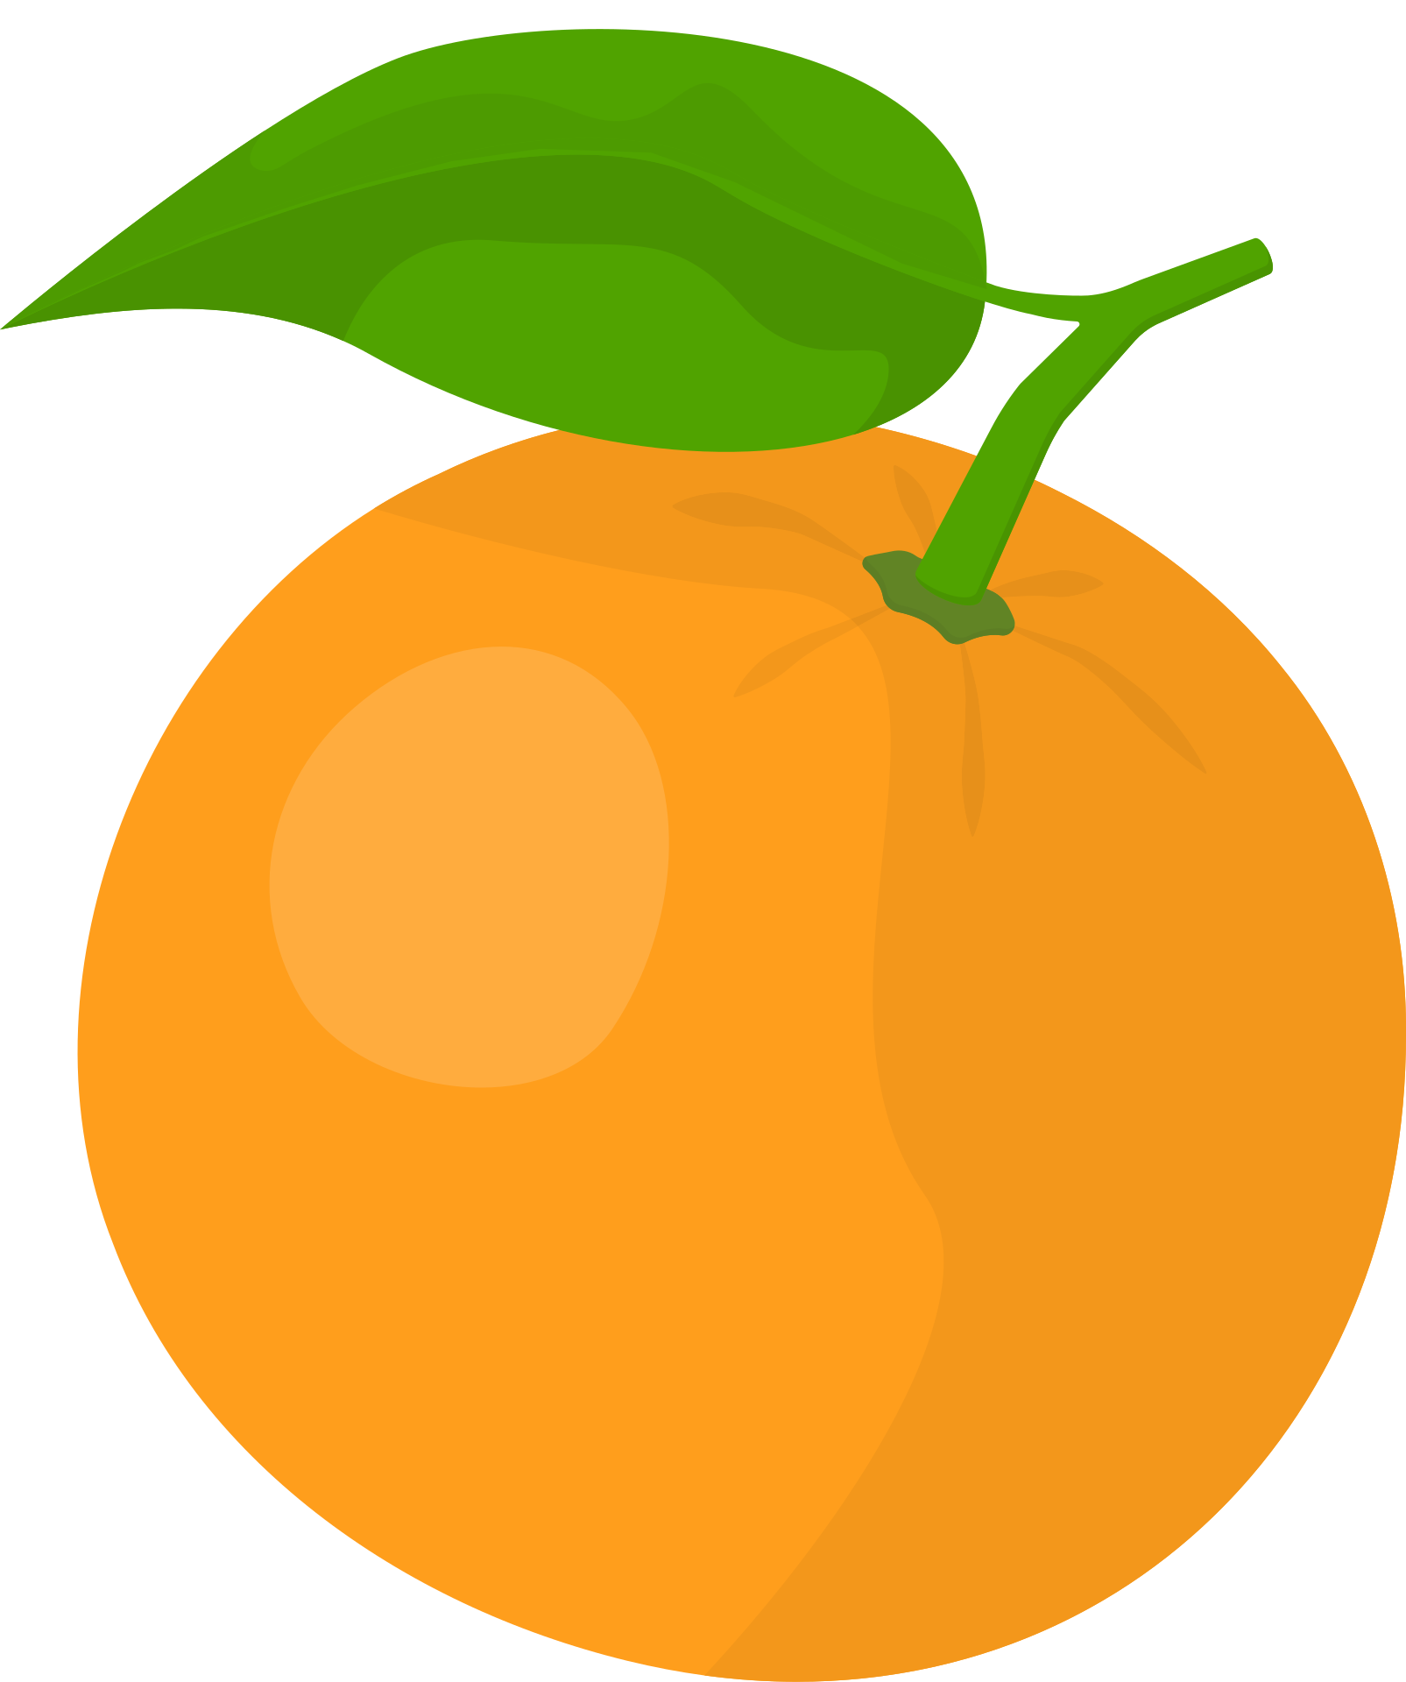


let's name objects that are color orange
orange
carrots
squash

